Slide 1
Power Virtual Server for Oracle Optimization
Run the same Oracle certified solution off-premises as you currently use on-premises
Enterprise class scalability, reliability, performance with best-in-class TCO leveraging Oracle hard partitioning
Build a hybrid cloud environment with Power Systems Virtual Server to run an off-premises Power stack identical to your existing on-premises Power-based infrastructure for Oracle workloads
Fully certified stack with PowerVM, AIX, IBM i, SAN-based storage, network adapters, providing full Oracle support
Meets Oracle’s hard partitioning requirements
Sub-capacity licensing – License only the CPUs available to Oracle Database and middleware
Optimize Oracle licensing to provide reduced TCO, lower than any hyperscale cloud environment
Full support for Oracle Database, RAC, Fusion Middleware, Applications
Highest off-prem scalable Oracle DB Single Instance capability
Superior storage resiliency, enterprise class platform with all flash NVM-E enabled network storage
All Oracle-on-Power offerings:
Oracle Database PeopleSoft
Oracle RAC Siebel
GoldenGate Oracle Retail
E-Business Suite FLEXCUBE
JD Edwards World and EnterpriseOne
… CC&B, BRM, MDM, Commerce, OEM, et al.
Power Virtual Server/ © 2024 IBM Corporation

Slide 2
PowerVS Flexible Deployment Model
VM based
Shared Processor Pool
Dedicated Host
Multitenant Host solution
Dedicated Cores
Shared Capped LPAR
Shared Uncapped LPAR
Reserved capacity at single core granularities with no oversubscription of capacity across SPPs
Pool-based deployment and resource control for simpler workload management
Exclusive use (all cores and memory available for use)
Same flexibility as on-premise Power deployments
Multiple shared processor pools for SW Licensing capping
Policy Placement
New
Up to 3 VPs for any EC<=3 (Power10 only)
Up to 2 VPs for any EC<=2 (POWER9)
Core-to-vCPU ratio of 1:1 when EC>3
Core-to-vCPU ratio of 1:1
Core-to-vCPU ratio of 1:20
Use Cases
Test / Dev environments
1st production environments
Bare-metal x86 servers / x86 VM Hyperscaler migration
Cost Optimized Disaster Recovery As a Service
Reduced Oracle S/W licensing costs by optimizing & limiting processor core usage
Oracle Database Consolidation Starter & Manual scaling
Lift and Shift from Power on-prem (P8 EOS, Datacenter Exit, …)
Large Oracle database consolidation (thx to CPU Sharing ) from x86, Power, Exadata, SPARC, and Cloud
Co-locate workloads (Oracle, OpenShift, LoP, IBM i, Applications, Database Alternatives …)
Consistent with Oracle's current hard partitioning guidelines, as long as LPM is not used with those LPARs running Oracle SW: https://www.oracle.com/assets/partitioning-070609.pdf
2
Notes:
https://cloud.ibm.com/docs/power-iaas?topic=power-iaas-creating-power-virtual-server#dedicated-host

Slide 3

Shared Processor Pools – License Optimization
Many software providers charge based on the number of processors
Reduce license cost by only licensing the cores configured in the pool
Leverage EC:VP ratio on Power10 for increased virtual processor capacity for virtual servers
© 2025 IBM Corporation
3

Slide 4
Oracle on Power – Lizenzierung Standard Edition 2 (SE2)
Grundprinzip Standard Edition 2
Standard-Edition wird “Pro Sockel” lizenziert
Aktuell wird von Oracle nur noch SE2 unterstützt
Eine Lizenz pro Sockel, maximal 2 Sockel pro Maschine
Dual / Multi-Chip-Module zählen als 2 oder mehr Sockel
Dieses Problem betrifft alle Architekturen, auch die leistungsstarken x86–Prozessoren von AMD + Intel
Somit bei Power10 Systemen nur S1014 eligibel für SE2
Inkl. speziellem “Oracle Standard Edition” Power Server S1014 mit 24 Cores
POWER9 Systeme: S922 = Single Chip Module, 2 Sockets, daher 2x SE2 Lizenz erforderlich
Keine Subcapacity Lizenzierung bei SE2 (auch wenn nur 1 Core für Oracle genutzt wird!)
Achtung: Bei mehreren LPARs darauf achten, dass diese auf demselben System installiert werden (wenn sinnvoll), da für jedes physische System 2x SE2 Lizenz erforderlich ist!
© 2025 IBM Corporation
4

Slide 5
Oracle on Power – Lizenzierung – Enterprise Edition (EE)
Grundprinzip Enterprise Edition
Alle den Oracle-LPARs zugewiesenen Cores (Anzahl Virtuelle Prozessoren bei “uncapped LPARs”) müssen lizenziert werden
Eine Lizenz pro Core
Oracle-LPARs können einem Shared Processor Pool (SPP) zugewiesen werden
Höchstgrenze der zu lizenzierenden Cores ist die Größe des SPP (Subcapacity Lizenzierung)
Auf einem System können mehrere SPPs definiert werden
© 2025 IBM Corporation
5

Slide 6
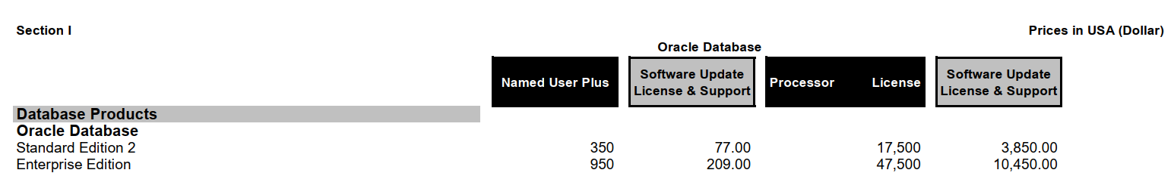
Oracle on Power – Lizenzkosten-Betrachtung Standard Edition SE2
Basierend auf offiziellen Listenpreisen: https://www.oracle.com/a/ocom/docs/corporate/pricing/technology-price-list-070617.pdf
1x S1014 mit 24 Cores (1 Dual Chip Module, 2 Sockel, SMT-8 = 192 logische Prozessoren (aus Oracle-Sicht = CPU_COUNT)
Lizenzkosten (SE2, 3 Jahre): 2 x $17.500 + 3x(2x $3.850 Update & Support) = $58.100
Lizenzkosten (EE, 3 Jahre): 24 x $47.500 + 3x(24x $10.450 Update & Support = $1.892.40
Power Virtual Server:
S922 – egal wie viele Cores = identisch wie S1014 da SE2 eligibel, $58.100 für 3 Jahre
S1022, E980, E1080 – Lizenzierung pro Core da DCM → EE
S1022: SW Lizenzen bereits ab 1 Core für 3 Jahre teurer, da EE erforderlich
© 2025 IBM Corporation
6

Slide 7
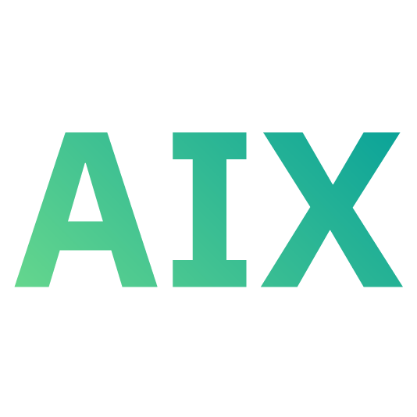
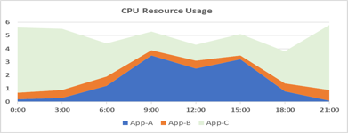
Oracle SW licensing cost optimization example
Without SPP
With SPP
VM1 Capped AIX 7.3 Oracle DB VP = 6 | VM2 Capped AIX 7.3 Oracle DB VP = 2 | VM3 Capped AIX 7.3 Oracle DB VP = 1 | VM4 Capped AIX 7.2 Oracle DB VP = 1 | VM5 Capped AIX 7.3 Oracle DB VP = 2
VM1 Uncapped AIX 7.3 Oracle DB Ent. = 5.25 VP = 6 | VM2 Uncapped AIX 7.3 Oracle DB Ent. = 1.25 VP = 2,3 | VM3 Uncapped AIX 7.3 Oracle DB Ent. = 0.25 VP = 1,2,3 | VM4 Uncapped AIX 7.2 Oracle DB Ent. = 0.75 VP = 1,2,3 | VM5 Uncapped AIX 7.3 Oracle DB Ent. = 1.5 VP = 2,3
Provision 5 VMs with 12 fixed cores = 12 Oracle licenses required
Oracle Licensing Optimization Benefits
Enable hybrid cloud environment to run off-premise Oracle workloads
Reduce the number of SW licenses by putting a limit on the number of processors an uncapped partition can use
Meets Oracle’s support and hard partitioning requirements
Fully certified stack w/ PowerVM, AIX, IBM i, SAN-based storage, network adapters
Full support for Oracle database, RAC, Fusion middleware, applications
Option to add and license only 1 incremental core at a time to a SPP
SPP
Reserved: 9 capped cores
Create Shared Process Pool with 9 capped cores
Provision 5 VMs with 9 cores entitled capacity
12 virtual processors with 1:1 EC:VP (S922)
18 virtual processors with 1:3 EC:VP (up to 50% savings)
9 Oracle licenses required
 | Oracle License w/ SPP | Without SPP | License Saving
SPP #1: Oracle DB cores to license | 9 | 12 | 3
© 2025 IBM Corporation
7
Notes:
Remember: VPtoEC ratio defines the number of Virtual Processors (VPs), rounded up to an integer, created by PowerVM for a VM as a ratio to the VM’s EC
So,
VM5: 5.25 EC → 6 VPs (round up)
VM6 1.25 EC → 2 VPs (round up)
VM7 0.25 EC → 1 VP (round up)
VM8 0.75 EC → 1 VP (round up)
VM9 1.5 EC → 2 VP (round up
For a minimum SPP size of 5.25+1.25+0.25+0.75+1.5 = 9
Note 1: SPP is a full core but we didn’t have to round up in this case
Note 2: VP total is 12 on 9 cores since each VM is rounded up
Note 3: If the other VMs are not busy, each VM has the potential to get 1 core per VP
Power6 and later have a core licensing factor of 1.0.
Oracle DB - (Reserved/Max capacity of pool is the limit!)
Power6: roundup( (2.25 + 1.25) * 1 ) = 4
Power7: roundup((2.25 + 1.25) * 1 ) = 4
Power8: roundup((2.25 + 1.25) * 1 ) =4
Power9: roundup((2.25 + 1.25) * 1 ) = 4
Power10: roundup((2.25 + 1.25) * 1 ) = 4 (As of 7/14/2022 Power 10 is not specifically listed in the Oracle document and falls under the “1.0” for “Other Multicore CPUs”)
EBS:
roundup((0.25 + 1.25 + 1.25) *1)=3 (Reserved/Max capacity of pool is the limit!)

Slide 8
Oracle Production Example (S1022)
As-is without SPP
12 cores used
12 Oracle licenses needed
As-is with SPP (without optimizations)
9 cores used and licensed for Oracle
VM price is 10% higher than without SPP
33% Oracle license savings (9 cores licensed)
NEW – with SPP pricing optimizations
13% improvement on PowerVS pricing
33% Oracle license savings (9 cores licensed for 12 VPs)
Up to 50% Oracle license savings with 1:3 EC:VP ratio (9 cores licensed for 18 VPs)
8
SPP = Shared Processor Pool SPC = Shared Processor Core
Note: Monthly USD prices shown
© 2025 IBM Corporation

Slide 9
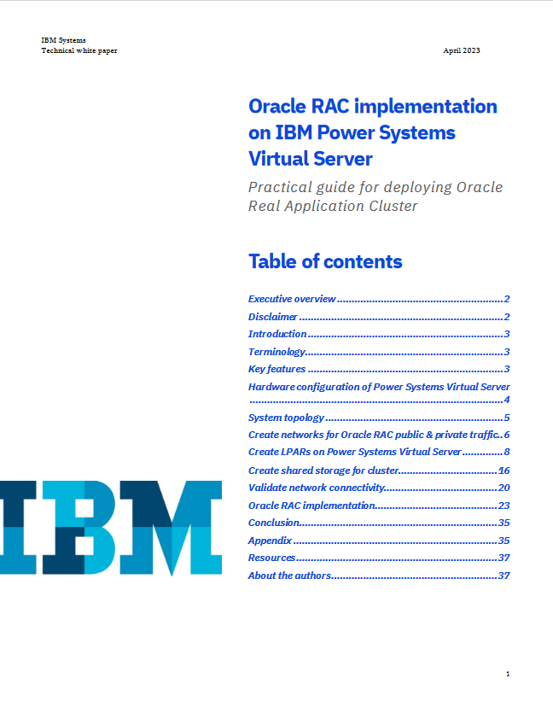
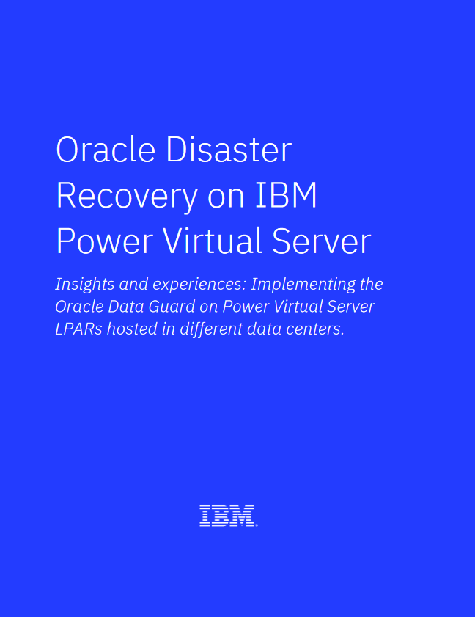
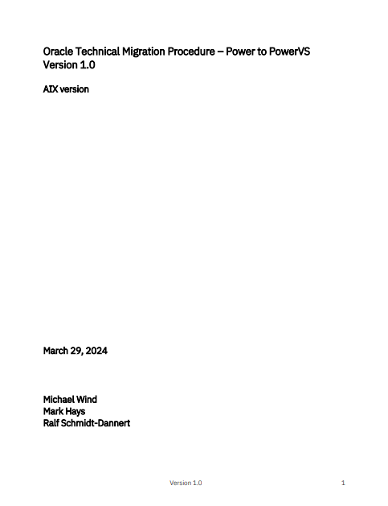
Oracle Database on IBM PowerVS Collaterals
Oracle RAC, Dataguard, Migration …
Implementation Guidance & Experience Feedback
Whitepaper Oracle RAC implementation on IBM Power Systems Virtual Server
Oracle Disaster Recovery on IBM Power Virtual Server
Oracle Technical Migration Procedure – Power to PowerVS
Oracle on Power Seismic Startseite
Präsentation Oracle and Oracle RAC on Power Virtual Server (Oktober 2024)
July 31 - Oracle on IBM PowerVS Spotlight - IBM Power Virtual Server Aufzeichnung und Präsentation
IBM Power vs Exadata and Oracle Cloud - Client Deck - 2025.Feb
9

